Slide 1

George Orwell and his books

Slide 2

Important words
Give a definition for these words:
Pen name – Eric Blair .
Author and Journalist – Orwell worked as a journalist for the BBC
Colonial Burma (now Myanmar) – Orwell travelled to Burma (India) to protect/defend the territory as a policeofficer
Spanish Civil War – he fought for democracy in the Spanish Civil War
Anti-totalitarianism – to be against dictatorship – opposite to (Fascism/Nazism/Communism – Russian Revolution
Social injustice – promise something that you never do
Satire – making fun of something to give a message – (Fattoria degli animali)
Dystopia – to describe the worst possible place to live - 1984
Surveillance – to control c/ have control
Freedom of speech –
Tuberculosis – he died of
Legacy – something we get from him

Slide 3
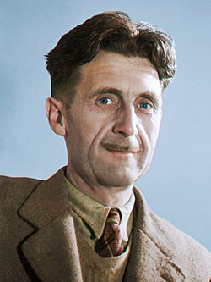
WHO IS THIS MAN?

Slide 4

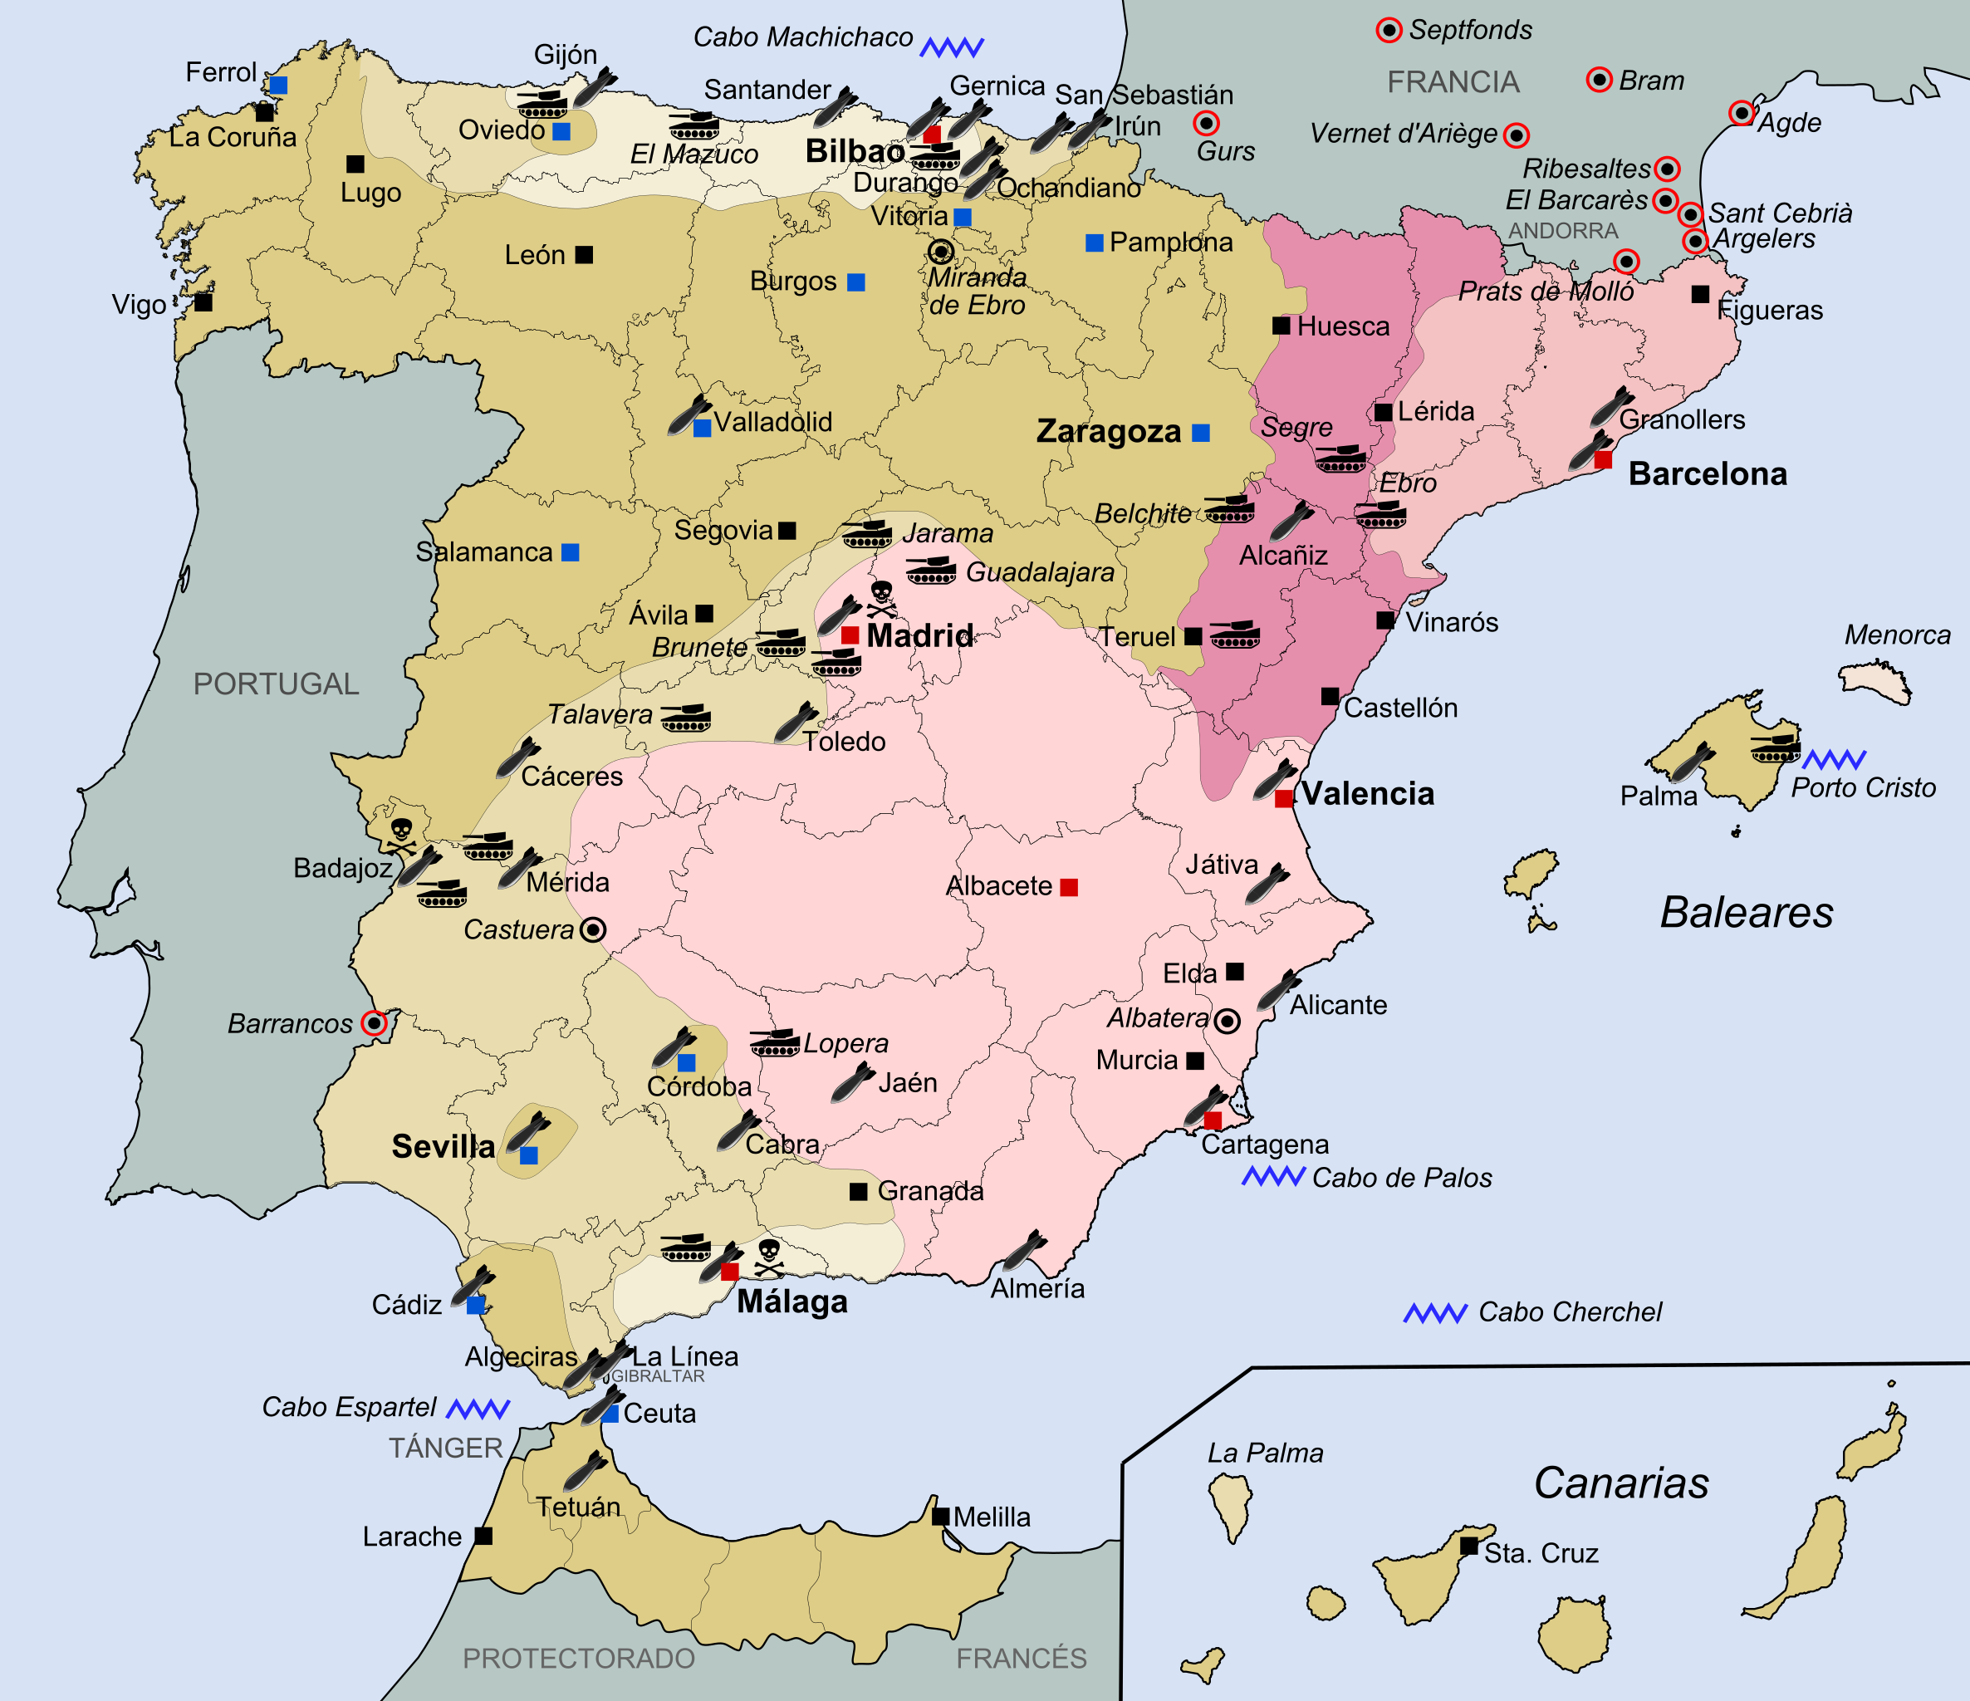
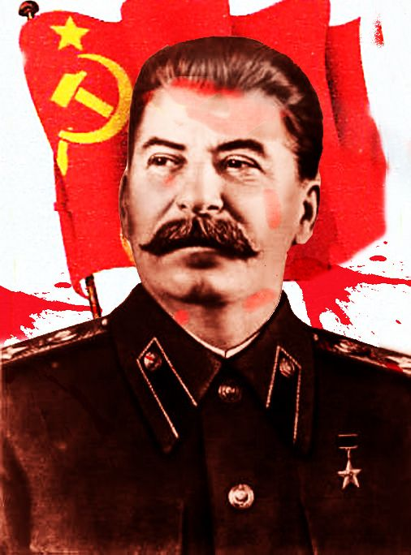
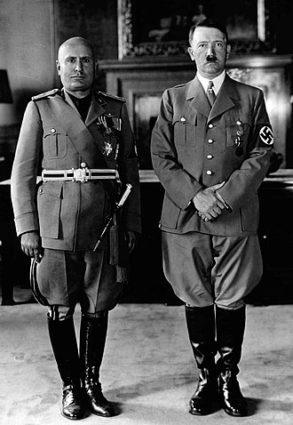
George Orwell - Biography
Who was George Orwell?
Biography
George Orwell was a famous English author whose most popular books are Animal Farm and 1984. He also wrote many essays about topics such as other writers, popular culture, politics, and writing.

Slide 5
George Orwell - Biography
Who was George Orwell?
George Orwell was born in 1903, as Eric Blair in India, which was then a part of the British Empire. He used the name George Orwell only for his writing.
He hated most of his time at school, but he developed his writing ability and even published some poems.
His parents couldn’t afford to send him to university, so his family encouraged him to return to Asia to become a policeman in Burma. His experiences there inspired his first novel, Burmese Days.
Orwell hated the empire and found it difficult being a policeman. He felt that many of the Burmese people hated him, because as a policeman he was a symbol of the empire. He eventually returned to England when he became sick and decided not to go back.
Back in England, Orwell decided to experience what life was like for poor people. He wore different clothes and used a different name, visiting the poorest parts of London. He wrote about these experiences and also about living as a teacher in Paris in Down and Out in Paris and London.
Orwell fought for the Republicans in the Spanish Civil War. This became the basis for his book Homage to Catalonia.
His two most famous books, Animal Farm and 1984, were attacks on totalitarianism – governments that don’t let people have any freedom.
Orwell died of tuberculosis at the age of 46. His legacy as a writer has continued to this day – he is remembered and respected by many.

Slide 6
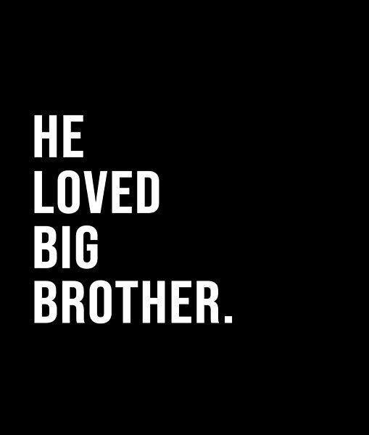
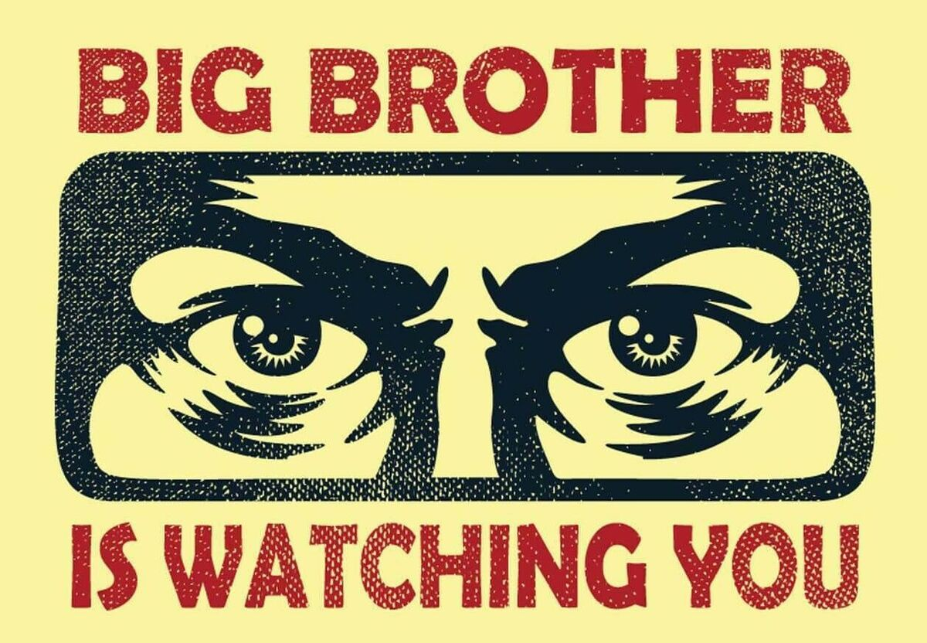
George Orwell - 1984
1984 was written in 1948 and published in 1949.
1984 is a story about a man, named Winston Smith, who works for the government in the future. This government controls everything, and controls and kills people who disagree.
They use propaganda (fake information that is spread to influence people's opinions or beliefs) and they even change the language, so that it becomes more difficult to think against the government. On television, Big Brother, a character created by the government, watches everyone.
Winston Smith falls in love with a woman, and together they try to stop Big Brother. They believe there are other people that will help them, but they all work for Big Brother.
They are caught by the government and sent to ‘Room 101’. Here they are tortured into changing their way of thinking, and they become brainwashed. The last line of the book is ‘He loved Big Brother’ – Winston’s mind has been changed forever, and he now likes the government.

Slide 7
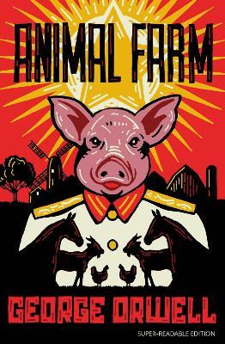
George Orwell – Animal Farm
Animal Farm
In Animal Farm, many animals live on a farm that is owned by a bad farmer. He does not care for the animals, and they are often left with no food.
Eventually, the animals decide to get rid of the farmer after listening to one of the pigs, and force him to leave the farm. They then decide to make the farm one run by animals, with their own sets of rules.
However, the pigs that manage the farm slowly change the rules, and lie to the animals. Many of the animals trust the pigs and forget the rules have been changed, allowing the pigs to control them just like the farmer did.
This story is an allegory, meaning its characters and events are symbols for other things.
Animal Farm is about the Russian Revolution and what happened after, where the people got rid of their king but replaced him with dictators – people who control a country completely, without offering any freedom – who behaved the same as kings.

Slide 8
Learning Objective
To understand the context in which Nineteen Eighty-Four was written.
Success Criteria
To know what life was like in 1948.
To explore the common themes of Orwell’s work.
To consider the text’s legacy.

Slide 9
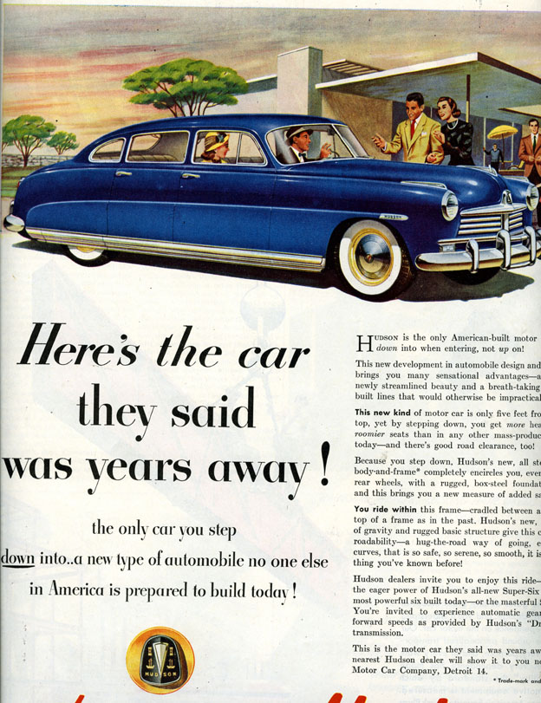
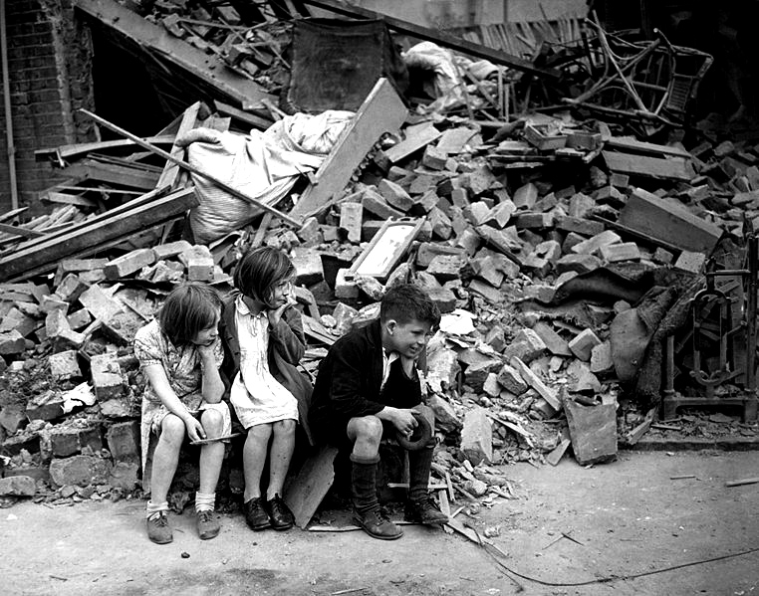
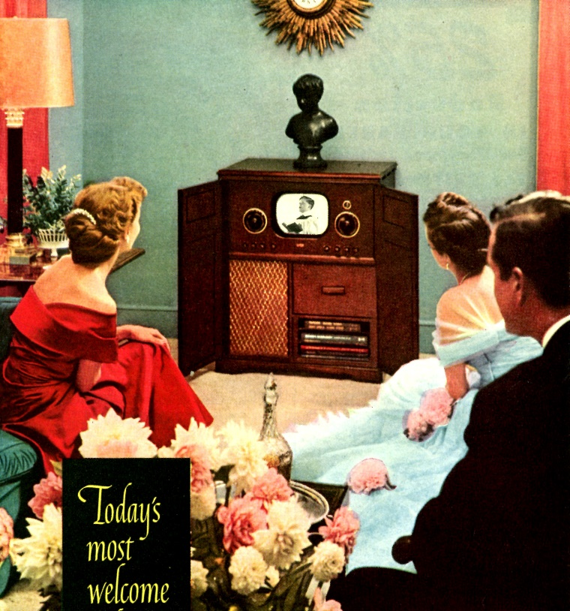
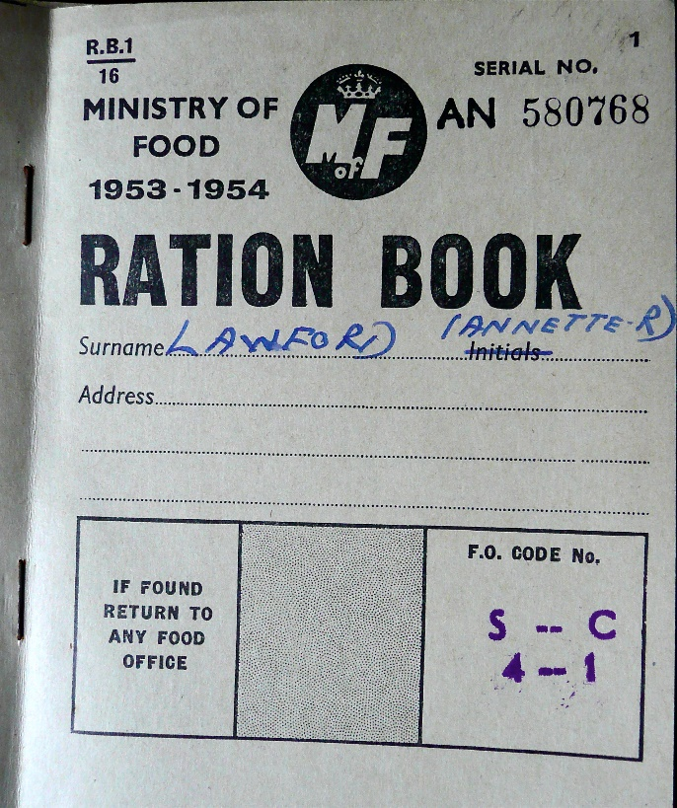
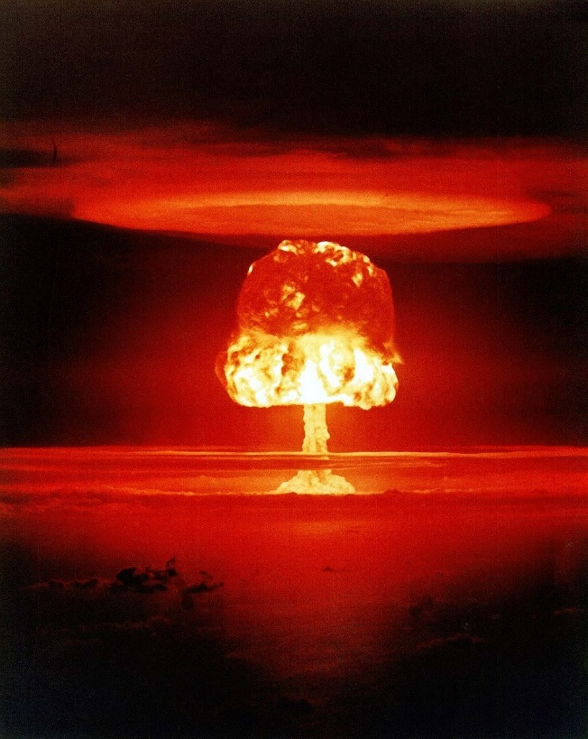
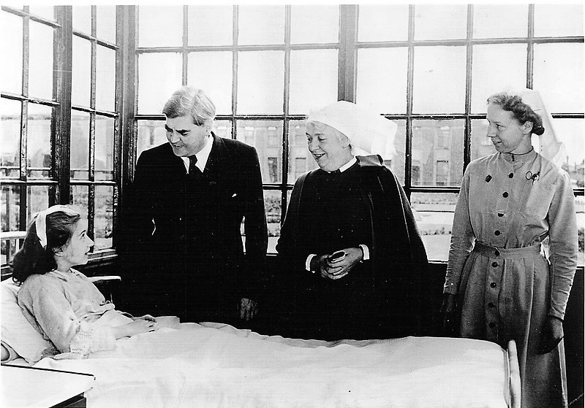
1948
What was life like at this time?
Discuss in groups what you already know.
Use the picture prompts to help you develop ideas.

Slide 10
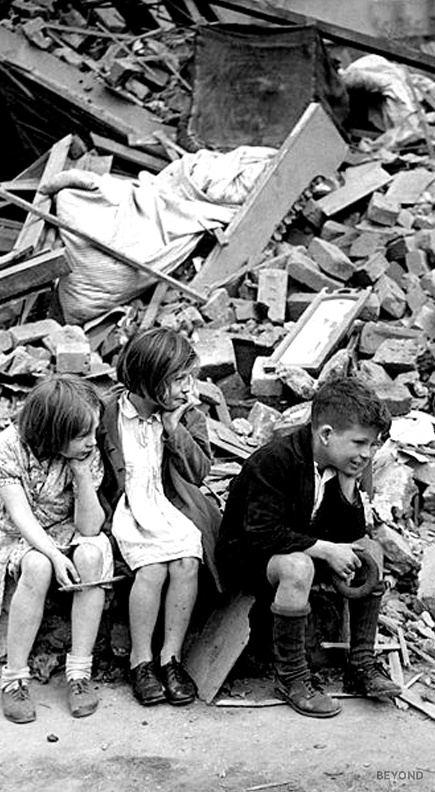
1948
Blitz Survivors
Second World War ended in 1945
Cities bore the scars of bombing
Large-scale rebuilding required

Slide 11
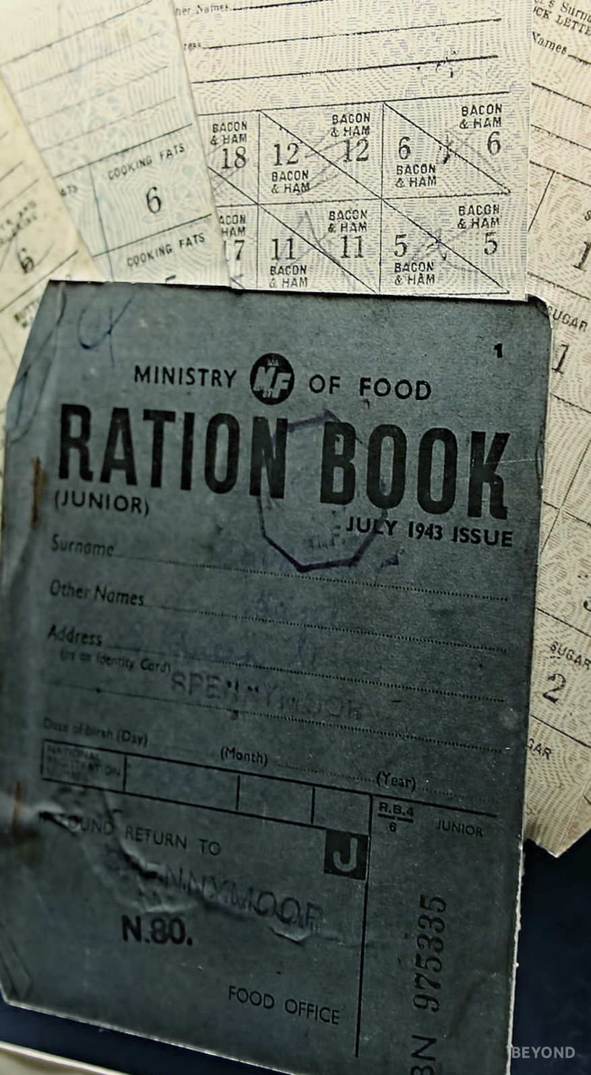
1948
Rationing
War-time deprivation continued until 1954
Sugar, eggs, butter, meat and clothing were among the items rationed
Ration books and coupons were intended to ensure fairness
Scarcity created a ‘black market’ for goods

Slide 12

1948
NHS
National Health Service founded on 5th July 1948
Established the principle of free healthcare for all, regardless of wealth

Slide 13
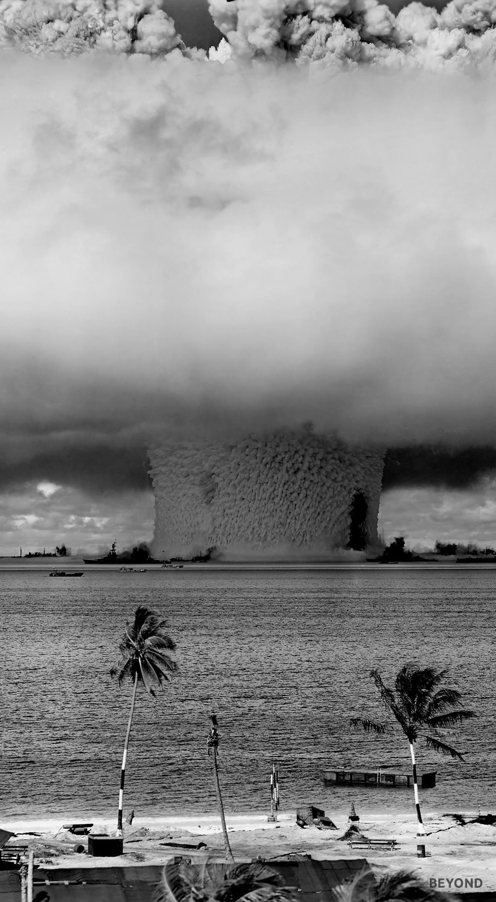
1948
Atomic Bomb
The bomb dropping Japanese cities of Hiroshima and Nagasaki effectively ended the Second World War (1945)
Instantly killed in excess of 100,000 civilians
Many more died slow deaths from radiation poisoning
Remains the only instance of atomic bombs being used in warfare but the threat of nuclear power continues to hang over our planet and seemed very real during the Cold War (1947-1991)

Slide 14

1948
Futurism and Leisure
Advancing technologies, coupled with the necessity to rebuild, pointed towards a radically different future
More affordable modes of travel impacted upon the natural rhythm of life
Colour seeped onto the big screen but household TVs (for the lucky few who had them) remained small and monochrome
Radio was the dominant form of information and entertainment

Slide 15
1948
1984
If the book’s called Nineteen Eighty-Four, why are we talking about 1948?
Nineteen Eighty-Four was written in 1948 (published in 1949).
Why Orwell chose 1984 as the temporal setting for his novel is not entirely clear; the date has no significant bearing on the narrative. It has been claimed that the author merely flipped the digits to arrive at an otherwise unspecified future date.
Others, however, consider the reversal more meaningful by creating a connection between the two dates – rather than being a random future, it can be seen as an extension of the times in which it was written.
Thinking about what you’ve learnt of life in 1948, how do you suppose this could be relevant to a novel set in a dystopian future?
Dystopian Describing an imagined society where there is great suffering or injustice.

Slide 16

Legacy
Orwell’s imagined future is now past, so why are we still learning about it?
Many of the themes of Orwell’s work, particularly Nineteen Eighty-Four, are pervasive: just as the real 1948 shared deep-seated anxieties and values with the fictional 1984, 21st century ideologies can be similarly traced backwards and forwards in time.
The term Orwellian has entered the dictionary to describe anything characteristic of the author’s work, particularly with reference to totalitarian practices. And since 1994 the Orwell Prize has been awarded ‘to celebrate honest writing and reporting, to uncover hidden lives, to confront uncomfortable truths, to promote Orwell’s values of integrity, decency and fidelity to truth’.
ideologies Belief systems; modes of thinking
totalitarian Systems of government that are oppressive and all-powerful

